Slide 1

Project/Team ID – 4CY9 Team Name – Insight Quads
Project Title – AI Powered Resume Analyzer
Project Domain – Data Science and Machine Learning
Project Guide - Ms. Appoorva Bansal
Team Members – Khushi Agrawal (PCE23CY032) , Navya Sharma (PCE23CY043) , Manvi Khandelwal (PCE23CY041) , Mridul Jain(PCE23CY042)

Slide 2
LITERATURE REVIEW: Comparison Table
Feature | Tool A 🎯 | Tool B 🚀 | Tool C 🔥 | Tool D 🌟
AI Accuracy | ⭐⭐⭐⭐ | ⭐⭐⭐ | ⭐⭐⭐⭐⭐ | ⭐⭐⭐⭐
Resume Parsing | ✅ Advanced | ✅ Basic | ✅ Moderate | ✅ Advanced
Keyword Matching | 🔍 Strong | 🔍 Medium | 🔍 Strong | 🔍 Very Strong
Customization | 🎨 High | 🎨 Low | 🎨 Medium | 🎨 High
ATS Compatibility | ✅ Yes | ❌ No | ✅ Yes | ✅ Yes
Free/Paid | 💰 Paid | 🆓 Free | 💰 Paid | 🆓 Free with Premium
User-Friendly | 😊 Very Easy | 😐 Moderate | 😊 Easy | 😍 Extremely Easy
Extra Features | 📊 Analytics | ✉️ Email Suggestions | 🏆 AI Ranking | 📌 Cover Letter Assistant

Slide 3
IDEA TITLE
DETAILED EXPLANATION OF THE PROPOSED SOLUTION:
-The AI model is trained to recognize industry-specific keywords, job-related skills, and contextual relevance, allowing it to assess candidates beyond simple keyword matching. It evaluates factors such as experience level, achievements, and project involvement, ensuring a more comprehensive analysis of each applicant. Additionally, the system can assign weighted scores to different criteria, enabling recruiters to focus on candidates who align best with the job role..
- By automating the screening process, companies can enhance efficiency, reduce hiring costs, and ensure a fair and data-driven recruitment process, ultimately leading to better hiring outcomes.
- The tool can also generate detailed reports, summarizing why certain candidates rank higher than others, helping hiring managers make informed decisions quickly.
HOW IT ADDRESSES THE PROBLEM:
--The AI-Powered Resume Analyzer addresses the problem of managing a high volume of resumes by automating the resume screening process. It scans and extracts key information from resumes, matches them with the job description’s required skills and qualifications, and ranks candidates based on how well they fit the role. This saves time, reduces human bias, and ensures consistent, efficient filtering of candidates. By streamlining the process, hiring managers can focus on the best-fit candidates, speeding up recruitment and improving hiring decision.
INNOVATION AND UNIQUENESS OF THE SOLUTION:
-- The AI-Powered Resume Analyzer stands out for its advanced use of AI and natural language processing to not only match keywords but also understand the context and relevance of candidate skills and experience. It ranks resumes dynamically based on job requirements, allowing for customizable criteria, and reduces human bias by focusing solely on qualifications. With real-time insights and feedback, the tool enables hiring managers to make faster, more informed decisions, making the recruitment process more efficient, accurate, and fair.

Slide 4

TECHNICAL APPROACH
1.*Resume Submission*
2. *Resume Parsing* - Extract key information (e.g., work experience, education, skills).
3. *Job Description Analysis* - Extract key requirements (skills, experience, qualifications).
4. *Keyword & Skill Matching* - Match resume content with job description requirements.
5. *Ranking Algorithm* - Rank resumes based on relevance to job requirements.
6. *Highlight Key Skills/Experience* - Automatically highlight the most relevant skills and experience in the resume.
7. *Bias Reduction Mechanism* - Ensure fairness by removing irrelevant biases (e.g., gender, age).
8. *Final Candidate Ranking* - Provide a list of candidates ranked by job fit.
9. *Insights & Feedback*- Generate insights on candidate strengths/weaknesses for hiring managers.

Slide 5
FEASIBILITY AND VIABILITY
Feasibility :
Technology Availability – NLP and AI-based resume parsers (like GPT, BERT) can extract and analyze key resume details effectively.
Data Processing – Machine learning models can be trained on job descriptions and resumes to assess candidate-job fit.
Integration – Can be integrated with existing ATS (Applicant Tracking Systems) via APIs.
Scalability – Cloud-based solutions allow for quick processing of large resume volumes.
Accuracy & Bias – Needs continuous improvement to minimize biases and improve precision
Viability:
Increased Efficiency: Automates the screening process, saving hiring managers significant time by quickly identifying resumes that match job requirements.
Scalability: Can handle high volumes of resumes, making it ideal for companies with large-scale hiring needs (e.g., tech firms, staffing agencies).
Accuracy: Uses natural language processing (NLP) to precisely match resumes to job descriptions, reducing the chances of overlooking qualified candidates.
Bias Reduction: AI can help minimize human bias in resume screening, promoting fairer and more objective evaluations based solely on qualifications.

Slide 6
IMPACT AND BENEFITS
POTENTIAL IMPACT ON THE TARGET AUDIENCE:
BENEFITS OF THE SOLUTION (SOCIAL, ECONOMIC, ENVIRONMENTAL, ETC.):
Faster Hiring Process: Speeds up resume screening and shortlisting.
Better Candidate Matching: Ensures alignment with job-specific requirements.
Reduced Bias: Promotes objective and fair candidate evaluation.
Cost Savings: Lowers recruitment costs by automating initial screening.
Improved Quality of Hires: Identifies candidates with the right skills and experience.
Scalable: Handles high volumes of resumes efficiently.
Enhanced Candidate Experience: Provides timely and relevant feedback.
Data-Driven Insights: Helps refine hiring strategies with actionable analytics.
Time Efficiency: Automates resume screening, saving time.
Accurate Matching: Aligns candidates with job requirements.
Bias-Free: Reduces human bias in the hiring process.
Cost-Effective: Lowers recruitment and resource costs.
Faster Decision-Making: Speeds up shortlisting and interview processes.
Scalable: Can manage large volumes of resumes with ease.
Improved Quality: Identifies top candidates more effectively.
Data-Driven: Provides actionable insights to optimize hiring.

Slide 7
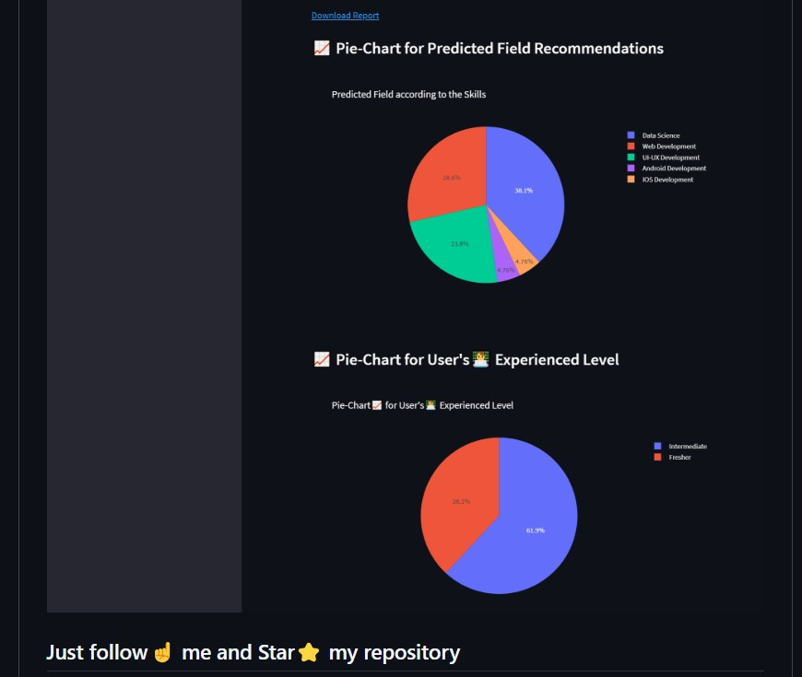
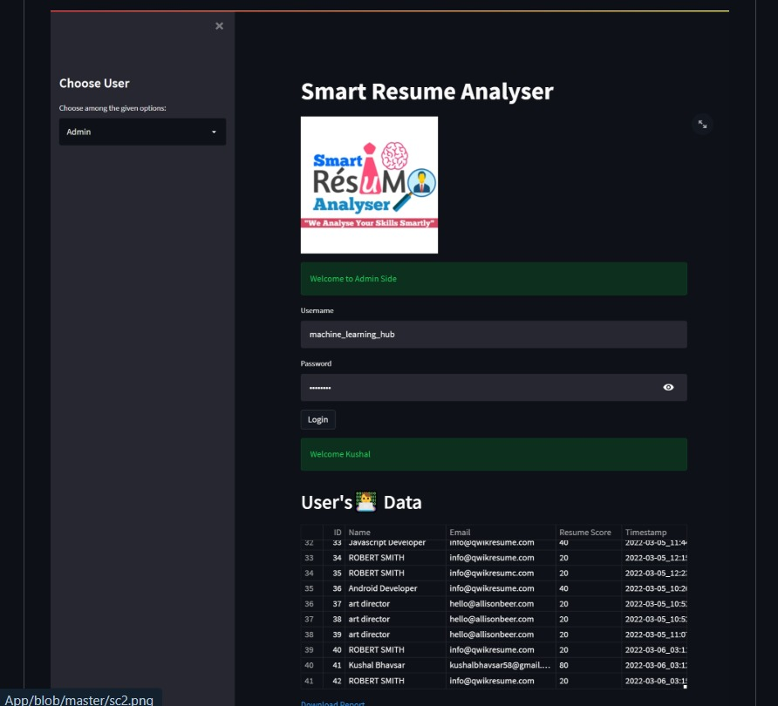
DEMO OF THE PROJECT

Slide 8
RESEARCH AND REFERENCES
Blog references :
https://www.hiringbranch.com/blog/artificial-intelligence-resume-screening
Linkedin references :
https://www.linkedin.com/posts/aroramri_built-an-ai-powered-resume-analyzer-in-roughly-activity-7240784791485210625-c1Z_
Research paper references by cornell university:
https://arxiv.org/abs/2401.08315
github references:
https://github.com/Spidy20/Smart_Resume_Analyser_App

Slide 9
THANK YOU!
@SIH Idea submission- Template

